Slide 1
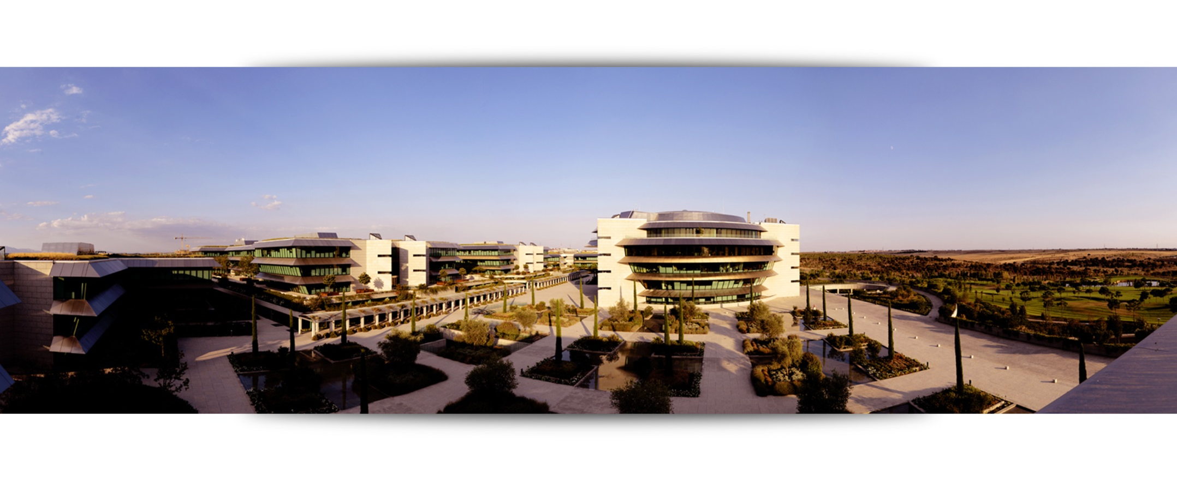

Risk Appetite - SHUSA
U.S.A. – 4 Quarter 2015
February 2016

Slide 2
0
Summary
Risk Appetite
Statement
Risk Appetite
Summary
SHUSA seeks to maintain a moderate risk profile, generating sustainable earnings, maintaining strong capital levels and actively managing liquidity to remain solvent at all times, including through adverse or severe stress situations.
SHUSA and its subsidiaries will take the risks required to maintain and grow their businesses, but only if the risks are well understood and can be managed and controlled.
Losses volatility
SHUSA will not place an undue amount of earnings or capital at risk for an entity of its size, complexity, and risk profile in any stress scenario.
Solvency
SHUSA will hold sufficient capital and liquidity to act as a source of strength for its subsidiaries, to satisfy current and future regulatory and internal requirements and to withstand the impact of an economic downturn as an autonomous subsidiary.
Liquidity
Implications in risk appetite axes
Concen-
tration
SHUSA will monitor, manage and control risk concentrations with single obligors, industry sectors and specific asset types.
Qualitative elements
SHUSA has a risk-averse approach to Operational, Conduct and Regulatory Risk. The Board is committed to a prudent risk management culture.

Slide 3
0
Summary
Risk Appetite
Statement
Risk Appetite
Summary
SHUSA suffers a high level of losses in the first year of the CCAR stress.
Severe but plausible scenario (FRB Adverse) has been used to test volatility of losses. This approach is consistent with the corporate methodology as it is the scenario used to consolidate the U.S. in the ICAAP stress exercise.
SHUSA is fully compliant with its Capital policy under baseline and stress.
The US capital metrics have been set with reference to the solvency stress run under a severely adverse scenario (BHC Stress) where the lowest CET1 ratio reported is 9.4%. The current level for December is 11.8%, still well above the stress limit of 6.5%.
Under the FRB adverse stress the maximum deterioration to CET1 takes place in Q2’15 and represents 25bps of CET1.
SHUSA Survival Horizon under stress is in amber at 82 days.
SHUSA Survival Horizon under stress is forecast to reach green status by the end of Q1 2016 as part of a remediation plan submitted to the FRB.
SHUSA is in breach of the Maximum exposure for counterparties rated below 5.0 and the Industry Exposure metric
The breach in the counterparties rated below 5.0 is primarily a result of the directive from the OCC to risk rate CRE Construction as low pass. SBNA is seeking relieve from the directive for the strongest sponsors.
The data extract for the SBNA metric has been found to be incomplete. Exposure has been recalculated and totals $5.1B which represents 6% of total portfolio. SBNA is analyzing the obligors by type (e.g. leasing companies, CRE special purpose vehicles, banks, others).
Losses volatility
Solvency
Liquidity
Concentration

Slide 4

0
Summary
Risk Appetite
Statement
Risk Appetite
Summary
Figures in $
 | Limit | Alert | 12/31 | 9/30
Losses Volatility
Loss in stress/ Profit before taxes¹ | 150% | 100% | 139% | 139%
Gross OpRisk losses / Gross margin² | 5% | 3% | 1.6% | 1.0%
Solvency
Minimum CET1 (transitional³), current |  | >10.5 % | <11% | 11.8% | 12.1%
Minimum CET1 (transitional³) under stress⁴ |  | >6.5 % | <7.5% | 9.4% | 9.4%
Max. leverage (Tier 1 Leverage): | current | >9.75% | <10.25% | 11.7% | 11.9%
 | under stress⁴ | >5% | <7% | 9.0% | 9.0%
Structural Funding Ratio |  | > 105% | < 100% | 109.6% | 110.9%
SC – Available committed liquidity / average projected net originations |  | 6 months | 7.5 months | 7.5 months | 11.8 months
Liquidity
(1/2)
Concern Watch No concern
1. 2015 CCAR FRB Adverse
2. Quarterly number
3. Fully loaded ratios are not available
4. 2015 CCAR BHC Stress
Bold letters: Risk Appetite statements.
Grey letters: thresholds (for monitoring)

Slide 5
0
Summary
Risk Appetite
Statement
Risk Appetite
Summary
Figures in $
 | Limit | Alert | 12/31 | 9/30
Survival period under stress (days):¹ | Local Systemic Idiosyncratic Systemic Global | ≥ 60 d ≥ 60 d ≥ 60 d | < 90 d < 90 d < 90 d | >90 >90 >90 | >90 >90 >90
Survival horizon under stress US²: | EPS Calculation³ | ≥ 60 d | < 90 d | 82d | 59d
Liquidity Coverage Ratio |  | >125% | <140% | 252.7% | 234.8%
Liquidity
(2/2)
Concentration
Max. exposure over Own Funds: | Single name Top 20 |  | 3.5% ($500MM) 56.8% | N/A 49.7% | 3.5% 46.3% | 3.5% 43.9%
Maximum Individual exposure with clients with rating < 5.0 |  |  | $100mm |  | 5 cases | 4 cases
Max. industry concentration over: | Total portfolio Portfolio excl. retail |  | 5.9% 8.8% | 5.3% 7.9% | 6.0% 8.9% | 6.7% 10.0%
CRE ($10.5 Bn) Multifamily ($11.5 Bn) |  |  | 12.3% 13.5% | 11.7% 12.9% | 10.1% 12.2% | 10.0% 12.1%
SC sub-prime assets over SHUSA Net Credit Exposure |  |  | 25% | N/A | 19.6% | 19.6%
SC RWAs/CET1 (estimated limit for December– illustration only) |  |  | 11% $38.7bn | $36.7bn | 37.7Bn | N/A
Qualitative elements
Frequency of material Operational events >$200k in potential losses | 16 | 9 | 3 SBNA 2 SCUSA 1 | 7 SBNA 3 SCUSA 4
Concern Watch No concern
Bold letters: Risk Appetite statements.
Grey letters: thresholds (for monitoring)
Group methodology
November value
US Enhanced Prudential Standards methodology, remediation plan approved

Slide 6
Losses
Stress
1
Losses
Summary
Macro
Scenarios
Margins
& NCL
GCB
concentration
Trading
portfolio
CVAs
Operational
Losses
Primary metric: | 2015 | Statement | Alert
Impact in profit before taxes (PBT) using CCAR FRB Adverse scenario | 139% PBT | 150% | 100%*
2015 CCAR FRB Adverse scenario has been chosen to run the “Loss in Stress” metric as it is used as the starting point for group ICAAP consolidation of the US operations. It is close to a plausible stress scenario.
The PBT used in CCAR FRB Baseline has been “normalized” to eliminate model uncertainty overrides that are not included in ICAAP.
CCAR PBT is not directly comparable to P-17 as it is US GAAP vs. IFRS and it is also impacted by lower asset balances.
PBT under stress in 2015 has a negative delta of $1.6Bn: net income is affected through a drop in net interest income that includes the effect of accelerated depreciation of SCUSA leases (+6%).
The concentration risk in GCB is high compared to the overall PBT of SBNA.
Figures in $mm |  | 2015e |  | Severity (FRB Adverse against BHC Base)
PBT CCAR |  | 695
^{Model Uncertainty} |  | ⁴⁴³
PBT w/o model uncertainty overlay |  | 1,138
Loss in stress |  | -1,585.4
Net Operating Income |  | -541 |  | -13%
Net Credit Losses |  | -827 |  | 24%
Concentration risk¹ |  | -118.5
Trading portfolio¹ |  | -8.9
Stressed CVA¹ |  | -3.0
Operational Risk |  | -87 |  | 32%
PBT |  | -139%
Updated with 4Q figures. All other values are from 2015 CCAR results

Slide 7
Escenarios Macro
Losses
Stress
1
Losses
Summary
Macro
Scenarios
Margins
& NCL
GCB
concentration
Trading
portfolio
CVAs
Operational
Losses
 | Base
Figures in % | 2013 | 2014 | 2015 | 2016
Real GDP | 3.1 | 2.1 | 3.2 | 3.0
Unemployment | 7.0 | 6.1 | 5.6 | 5.4
3M LIBOR | 0.2 | 0.4 | 1.2 | 2.1
10Y Treasury | 2.7 | 2.7 | 3.0 | 3.2
HPI (All Transactions) | 5.0 | 4.6 | 1.3 | 2.5
Manheim Index ¹ | -0.6 | -0.2 | 0.3 | 2.0
S&P 500 Index | 24.8 | 12.6 | 6.7 | 6.8
FRB Adverse
2014 | 2015 | 2016
1.2 | -0.2 | 1.4
6.4 | 7.6 | 8.0
1.1 | 3.0 | 4.8
3.3 | 4.6 | 5.4
3.5 | -5.0 | -3.0
-0.5 | -3.2 | 1.3
5.9 | -16.3 | -7.8
 | Base Line | FRB Adverse
Summary | Steady growth in the U.S. economy | Mild recession driven by inflation, reflected across most segments of the economy
Narrative | Strong Annual GDP growth and steadily declining unemployment rate generate increased wealth and continued recovery in housing prices and consumer spending | Inflation unexpectedly rises far above target, causing an increase in funding costs and a drawdown of corporate deposits. Equity and real estate prices decline significantly, though there is some recovery within the forecast horizon
Drivers and Reaction | Fed winds down stimulus programs, raising interest rates in mid-2015 | Recession precipitated by higher-than expected inflation, which strains budgets, increases funding costs, and damages asset value
Used car price index
Notes:
What is the Manheim index

Slide 8
Losses
Stress
1
Losses
Summary
Macro
Scenarios
Margins
& NCL
GCB
concentration
Trading
portfolio
CVAs
Operational
Losses
GDP
Distance between cumulative 9Q Growth (Base vs Stress)
Total distance
Comparison with other scenarios
FRB Adverse |  | FRB Severe | BHC Stress | Mid-Cycle Severe
-7.2% |  | -9.4% | -10.8% | -11.8%
5.1% |  | -0.4% | -2.9% | -4.7%
2.8% |  | 4.1% | 5.1% | 4.8%
-25.8% |  | -37.4% | -30.3% | -40.5%
-30.3% |  | -44.1% | -32.2% | -37.1%
-49.5% |  | -46.4% | -49.5% | -50.6%
3.0% |  | -2.0% | -0.6% | -1.5%
2.9% |  | -2.2% | -0.6% | -1.6%
2.6% |  | -1.0% | 0.3% | 0.0%
FRB Adverse scenario is characterized by a global weakening in economic activity and increase in U.S. inflationary pressures that result in a rapid increase in both short- and long-term U.S. Treasury rates.
Bank funding costs react strongly to rising short-term rates, as commercial deposits are unusually drawn to institutional money funds, which re-price promptly in response to changes in short-term Treasury rates. Consumer deposits are also assumed to be drawn to higher-yielding alternatives.

Slide 9
Probabilidad escenario macro
Losses
Stress
1
Losses
Summary
Macro
Scenarios
Margins
& NCL
GCB
concentration
Trading
portfolio
CVAs
Operational
Losses
The FRB Adverse scenario represents a mild recession with inflationary impacts and rising interest rates. Generally, it is less severe than the historical recessions of the early 1980s and 2008.
Real GDP (YoY %)
Stress scenario:
GDP’15: -0,5%
Historical series:
GDP < 1%: 4 times
GDP < 0%: 3 times
Stress
Unemployment (%)
Stress scenario:
Unemp’16: 8,0%
Historical series:
Unemp> 6%: 4 times
Unemp> 8%: 2 times
Stress

Slide 10
Losses
Stress
1
Losses
Summary
Macro
Scenarios
Margins
& NCL
GCB
concentration
Trading
portfolio
CVAs
Operational
Losses
Displays the difference between CCAR BHC Base and FRB Adverse. Total asset balances show the decline between the Base and Stress at the end of the 9 quarters. Interest Income and Provisions show the difference between Base and Stress for the cumulative 9 quarters.
4Q14-4Q16 | Total Assets | Interest Income | Provisions*
Δ in stress | -10% (-$12.5bn) | +2% (+$0.4bn) | +4% (+ $0.4bn)
Figures in local currency
* Total consolidated provisions for SHUSA over the 9 quarters CCAR stress do not substantially increase. At an SBNA portfolio level the % changes are substantial against base due to the low level of current provisioning in the benign credit environment. SCUSA provisions are already high in baseline and, although they increase in year 1 of the stress, total provisions over the 9 quarters remain unchanged over base.

Slide 11
Losses
Stress
1
Losses
Summary
Macro
Scenarios
Margins
& NCL
GCB
concentration
Trading
portfolio
CVAs
Operational
Losses
 |  |  | Binding Exposure | Rating | % Equity¹ | RORAC²
ANHEUSER-BUSCH INBEV SA/NV |  |  | 500.0 | 7.8 | 3.75% | 55.50%
AT&T |  |  | 500.0 | 7.0 | 3.75% | 20.76%
WAL-MART STORES INC |  |  | 479.7 | 8.7 | 3.60% | 32.44%
CARGILL INCORPORATED |  |  | 431.8 | 7.4 | 3.24% | 16.38%
INTERNATIONAL BUSINESS MACHINES |  |  | 420.7 | 8.1 | 3.16% | 38.84%
TOYOTA MOTOR CREDIT CORP |  |  | 375.0 | 7.8 | 2.81% | 61.07%
AMERICAN TOWER CORP |  |  | 340.0 | 5.9 | 2.55% | 10.18%
MERCK & CO INC |  |  | 325.0 | 8.5 | 2.44% | 61.55%
THE BOEING COMPANY |  |  | 306.4 | 7.5 | 2.30% | 22.77%
FREEPORT-MCMORAN INC |  |  | 291.7 | 4.5 | 2.19% | 2.19%
HP INC |  |  | 269.4 | 6.7 | 2.02% | 10.16%
NEXTERA ENERGY CAPITAL HOLDINGS |  |  | 263.3 | 6.5 | 1.98% | 15.22%
FIRSTENERGY CORP |  |  | 261.0 | 5.5 | 1.96% | 10.86%
BALL CORPORATION |  |  | 252.2 | 5.6 | 1.89% | 5.35%
JOHNSON & JOHNSON |  |  | 250.0 | 9.2 | 1.88% | 13.13%
PFIZER INC |  |  | 230.0 | 8.7 | 1.73% | 6.47%
TIME WARNER INC |  |  | 228.5 | 6.3 | 1.71% | 87.36%
THE KRAFT HEINZ COMPANY |  |  | 222.6 | 5.6 | 1.67% | N/A
COLGATE-PALMOLIVE COMPANY |  |  | 220.5 | 8.4 | 1.65% | 14.28%
ABBOTT LABORATORIES |  |  | 215.0 | 7.8 | 1.61% | 14.17%
TOTAL |  |  | 6,382.8 |  | 47.90%
Monitoring Metric: Concentration losses arises from a model (Montecarlo) that measures (with a probability of 1 in 40 years) the granularity of the GCB portfolio penalizing:
Concentration in big counterparties
Low granularity of the portfolio
Credit quality in big counterparties
Level: concentration risk exposure obtained from the model amounts to $ 263.3 MM, equivalent to the 12th counterparty from top 20 MRG exposures. Loss is calculated with a 45% LGD.
Figures in $ | EAD | LGD 45%
Concentration risk | 263.3 MM | 118.5 MM
Equity % of SBNA
RORAC information carries a delay of 2 months. RORAC represents November 2015 data
Notes:
*RORAC information carries a delay of 2 months. RORAC represents November 2015 data.

Slide 12
Losses
Stress
1
Losses
Summary
Macro
Scenarios
Margins
& NCL
GCB
concentration
Trading
portfolio
CVAs
Operational
Losses
Monitoring Metric: stress in trading portfolio assuming 1 month under stress (since 2007 only higher losses are taken once every 60 months, 1 month every 5 years) and poor performance over the remaining 11 months. The trading activity represents the SBNA client facilitation portfolio.
Figures in USD MM
A.- Loss scenario (1 month)
Loss in Trading Portfolio | - 0.7
Revenues (due to sales) | N/A
Subtotal 1 month (stress) | - 0.7
B. Recovery scenario (11 months)
Original Budget | -19.9
% poor performance 11 months | -41.6%
Subtotal | -8.3
Loss impact on the trading portfolio
-8.9

Slide 13
Losses
Stress
1
Losses
Summary
Macro
Scenarios
Margins
& NCL
GCB
concentration
Trading
portfolio
CVAs
Operational
Losses
Monitoring metric: stress in CVAs by counterparty to a 60% LGD. To be considered in each year of stress.
Level: USD -13.0 MM
MM local currency | CVA Month1x |  | CVA LGD 60% |  | Loss Impact
USA | -9.2 |  | -12.2 |  | -3.0

Slide 14
Losses
Stress
1
Losses
Summary
Macro
Scenarios
Margins
& NCL
GCB
concentration
Trading
portfolio
CVAs
Operational
Losses
Primary metric: | 4Q15 | Statement | Alert
Gross Operational Losses/ Gross margin (quarterly) | 1.6% | < 5% | 3%
Gross Operational Losses / Gross margin (limit 5%)
%
%
%
%
%
The value for Net Operational Losses / Gross margin for 4Q15 was 1.43% for comparison with the Group Risk Appetite metric.
47% increase quarter over quarter in Gross Losses (4Q2015 = $35.1MM / 3Q2015 = $23.8MM). Primary driver of Gross loss increases were 2 large SBNA events: 1.) Potential Fines for remediation of overdraft (OD) fees that were assessed to customers who “opted-in” under Regulation E. (Confidential and Privileged) for $13.5MM and 2.) an understated loan expenses resulting in a one-time charge-off to correct accounting errors for $5.8MM.
Notes:
Not sure what to put in the highlighted area.

Slide 15
2
Solvency
CET1
Projected CET1
deterioration
Leverage
Jump to default
Top 5
Primary metric: | Level 12/31 | Statement | Alert
Minimum CET1 (transitional) ratio | 11.8% | >10.5% | <11%
Monitoring metric Worst quarter of projected CET1 (transitional) under BHC Base | 11.4% (4Q16) | >10.5% | <11%
Primary metric: | Level | Statement | Alert
Worst quarter of projected CET1 (transitional) under BHC Stress | 9.4% (4Q16) | 6.5% | 7.5%
Appetite under BHC Base (transitional)
Appetite under BHC Stress (transitional)
%
%
Notes:
Done

Slide 16
2
Solvency
CET1
Projected CET1
deterioration
Leverage
Jump to default
Top 5
Monitoring metric: Maximum deterioration on projected CET1 (3 years global ICAAP or similar) from base case to stressed case
Threshold: N/A
Level: -197 pbs (4Q16)
11.4%
-293 pbs
10.7%
+174 pbs
Stress
-197 pbs
-78 pbs
2014Q3
2016
Earnings
Others
RWAs
Notes:
Try and see if they can tell me what is included in other.

Slide 17
2
Solvency
CET1
Projected CET1
deterioration
Leverage
Jump to default
Top 5
Primary metric: | Level 12/31 | Statement | Alert
Minimum leverage ratio (Tier 1 leverage) current | 11.7% | 9.8% | 10.3%
Primary metric: | Level | Statement | Alert
Minimum leverage ratio (Tier 1 leverage) under BHC Stress | 9.3% | 5% | 7%
Appetite under BHC Base
Appetite under BHC Stress
%
%
%
%
%
%
%
%
Notes:
Is leverage ratio fully loaded?
What quarters are these levels?

Slide 18
2
Solvency
CET1
Projected CET1
deterioration
Leverage
Jump to default
Top 5
Monitoring metric: Impact on CET1 ratio of an scenario where top 5 GCB default simultaneously with LGD 45%
Threshold: N/A
Level: 95 pbs ($1,049.4 MM)
Top 5 GCB | Rating | Bind. Exp. $ MM | Industry
ANHEUSER-BUSCH INBEV SA/NV | 7.30 | 500.0 | Telecom.
AT&T | 7.50 | 500.0 | Agricultural Goods and Services
WAL-MART STORES INC | 6.00 | 479.6 | Automobile Manufacturing
CARGILL INCORPORATED | 8.70 | 431.8 | Consumer Goods and Services
INTERNATIONAL BUSINESS MACHINES | 7.80 | 420.7 | Insurance company
TOTAL |  | 2,332.2
Severity (45%) |  | 1049.4
CET1 Impact |  | -95 pbs
Notes:
Need to verify the values

Slide 19
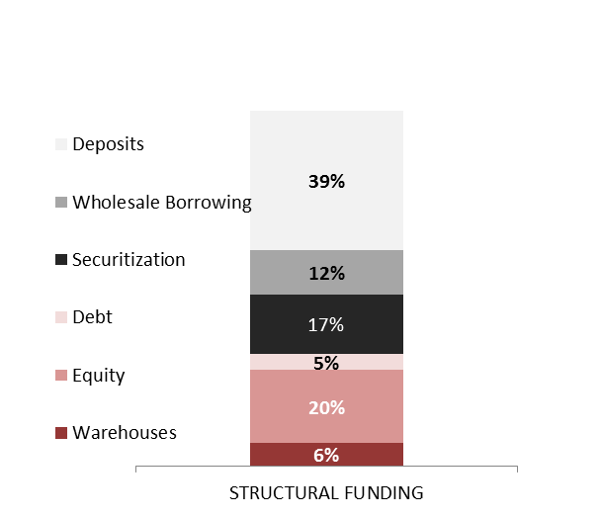
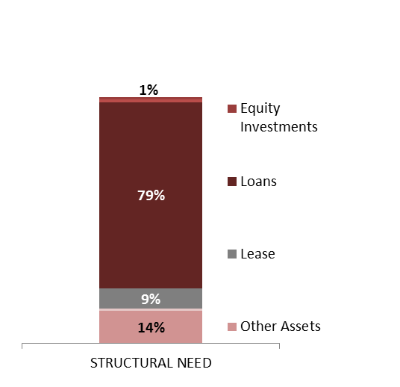
3
Liquidity
Structural Liquidity
LCR
Short term Liquidity
Primary metric: | 4Q15 | Statement | Alert
Structural Funding Ratio | 109.6% | < 100.0% | < 105.0%
Structural Funding Ratio
Structural Funding Sources and Needs
109.6%
Structural funding needs are met with stable funding sources.
Commercial gap (Loans – Deposits) supported with long term funding.
As of December 31st

Slide 20
3
Liquidity
Structural Liquidity
LCR
Short term Liquidity
Primary metric: | 4Q15 | Statement | Alert
LCR (Liquidity Coverage Ratio): | 252.7% | >100.0% | 105.0%
LCR (Limit: 100%)
%
The ratio declined to the lowest level at 93% in 1Q14, LCR shows an upward trend over 2015.
From 1Q14, LCR has consistently increased, mainly due to increases in HQLA. New purchases over 2015 on investment portfolio are derived from liquidity stress test results, need to hold high liquid assets in order to comply with regulatory requirements.
As of December 31st
* Subsidiaries with lending activity. This ratio considers structural (no commercial) intragroup funding, thus excluding intragroup exposures arising from commercial activity with clients (e.g stand by letters of credit granted to subsidiaries’ clients by SAN)

Slide 21
3
Liquidity
Structural Liquidity
LCR & Intragroup funding
Short term liquidity
Primary metric | 4Q15 | Statement | Alert
Survival period under stress
Local systemic crisis | >90 d | > 60 days | > 90 days
Secondary metric | 4Q15 | Statement | Alert
Survival period under stress
Idiosyncratic SAN Systemic Global crisis | >90 d >90 d | > 60 days > 60 days | > 90 days > 90 days
Survival Period – Systemic Local
Survival Period – Idiosyncratic SAN
Survival Period – Systemic Global crisis
The limit represents a timeframe that is more conservative than the regulatory definition of 30 days. The 90 days provide a more complete overview of potential mismatches between inflows and outflows.
As of December 31st

Slide 22
3
Liquidity
Structural liquidity
LCR & Intragroup funding
Scenario Assumptions
Stress factors are indicative of those presented in the December analysis.
As of December 31st
“Next Generation System-Wide Liquidity Stress Testing”, IMF Working Paper, January2012, Christian Schmieder et al.
Approximate comparison in order to contextualize. Santander Bank scenarios have more detail and granularity in their hypotheses.

Slide 23
4
Concentration
Counterparties
and top20
Non Investment
Grade
Industry Sectors
Primary metric: | 12/31 | Statement | Alert
Max exposure/equity: Single name ($500MM) Top 20 – Corporates | 3.5% 46.3% | 3.5% 56.8% | N/A 49.7%
 |  |  | Binding Exposure | Rating | % Equity¹ | RORAC²
ANHEUSER-BUSCH INBEV SA/NV |  |  | 500.0 | 7.8 | 3.75% | 55.50%
AT&T |  |  | 500.0 | 7.0 | 3.75% | 20.76%
WAL-MART STORES INC |  |  | 479.7 | 8.7 | 3.60% | 32.44%
CARGILL INCORPORATED |  |  | 431.8 | 7.4 | 3.24% | 16.38%
INTERNATIONAL BUSINESS MACHINES |  |  | 420.7 | 8.1 | 3.16% | 38.84%
TOYOTA MOTOR CREDIT CORP |  |  | 375.0 | 7.8 | 2.81% | 61.07%
AMERICAN TOWER CORP |  |  | 340.0 | 5.9 | 2.55% | 10.18%
MERCK & CO INC |  |  | 325.0 | 8.5 | 2.44% | 61.55%
THE BOEING COMPANY |  |  | 306.4 | 7.5 | 2.30% | 22.77%
FREEPORT-MCMORAN INC |  |  | 291.7 | 4.5 | 2.19% | 2.19%
HP INC |  |  | 269.4 | 6.7 | 2.02% | 10.16%
NEXTERA ENERGY CAPITAL HOLDINGS |  |  | 263.3 | 6.5 | 1.98% | 15.22%
FIRSTENERGY CORP |  |  | 261.0 | 5.5 | 1.96% | 10.86%
BALL CORPORATION |  |  | 252.2 | 5.6 | 1.89% | 5.35%
JOHNSON & JOHNSON |  |  | 250.0 | 9.2 | 1.88% | 13.13%
PFIZER INC |  |  | 230.0 | 8.7 | 1.73% | 6.47%
TIME WARNER INC |  |  | 228.5 | 6.3 | 1.71% | 87.36%
THE KRAFT HEINZ COMPANY |  |  | 222.6 | 5.6 | 1.67% | N/A
COLGATE-PALMOLIVE COMPANY |  |  | 220.5 | 8.4 | 1.65% | 14.28%
ABBOTT LABORATORIES |  |  | 215.0 | 7.8 | 1.61% | 14.17%
TOTAL |  |  | 6,382.8 |  | 47.90%
Figures in MM
AT&T continues to be the largest single counterparty exposure due to a non-revolving line of credit established in January 2015.
ANHEUSER-BUSCH INBEV SA/NV also the largest counterparty Quarter 4
Maximum Individual Exposure trend (lim. 3.5% equity)
% over equity
Top 20 trend (limit 56.8% equity)
% over equity
Equity % of SBNA
RORAC as of November2015
Notes:
Need to update the % of equity part.

Slide 24
4
Concentration
Counterparties
and top20
Non Investment
Grade
Industry Sectors
Secondary metric | Threshold | 12/31
Maximum exposures in MM: Rating < 5.0 | $100 MM | 5 cases
The # of counterparties with Santander Risk Rating < 5.0 and exposure > $100MM metric is in breach (5 obligor groups) when CRE loans are aggregated by one obligor.
Cases:
 | Obligor name | Exp. (MM) | SRR
GCB | Freeport INC | $292 | 4.8
 | Vale SA | $150 | 4.8
 | Teekay Offshore | $109 | 4.9
Investment CRE | Nathan Berman | $110 | 4.6
 | Adam America RE | $104 | 4.7

Slide 25
4
Concentration
Counterparties
and top20
Non Investment
Grade
Industry Sectors
Secondary metric: | Threshold | 12/31
Industry concentration Over total portfolio Over total portfolio excl. retail | < 5.9% < 8.8% | 6.0% 8.9%
Secondary metric: | Threshold | 12/31
Local Metrics: Real Estate CRE Multifamily | 12.3% 13.5% | 10.1% 12.2%
Industry breakdown
Real Estate – Exposures and limits
% Total portfolio excl. retail
% Total portfolio
Portfolio | Expos. (mm) | % Total portfolio | Total portfolio limit
CRE | $8,600 | 10.1% | 12.3%
Multifamily | $10,400 | 12.2% | 13.5%
1
¹ Industries with a concentration level lower than 3.90%.
Key: Concern Watch No concern

Slide 26
5
Qualitative
elements
Operational Risk
Primary metric: | 4Q15 | Statement | Alert
Frequency of material Operational events >$200k in potential losses | 3 SBNA 2 SCUSA 1 | 16 | 9
We calibrated this metric to be consistent with the limits for gross losses / gross margin
We estimated the average loss associated with each material risk event and calculated the frequency of material risk events that could occur before SHUSA breaches the gross losses implied by the red and amber thresholds of the gross losses / gross margin metric for SHUSA

Slide 27
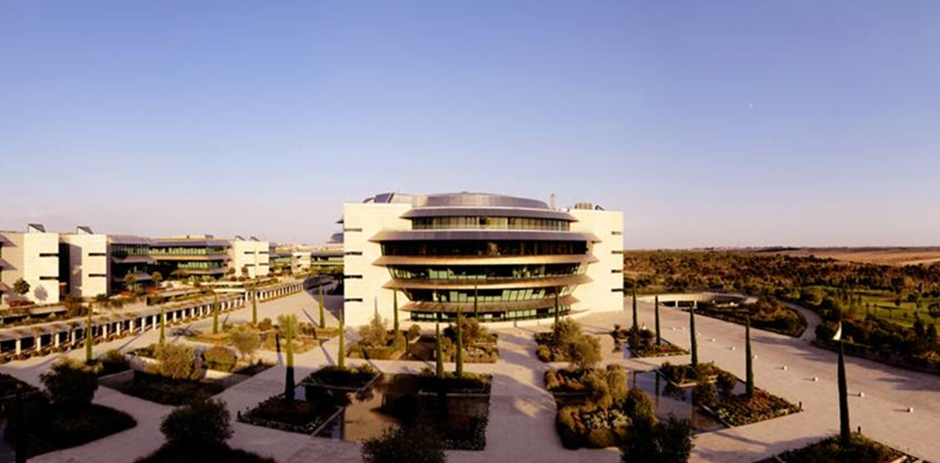
Appendix

Slide 28
SHUSA Risk Appetite Statement – full list of metrics
Monthly Metrics
Risk type | Entity | Metrics |  |  |  | BHC Baseline scenario |  |  | BHC Stress scenario
 |  |  | Dec 15 | Nov 15 | Oct 15 | BHC Base | Amber trigger | Red limit | BHC Stress | Amber trigger | Red limit
Capital adequacy¹ | SHUSA³ | * Common Equity Tier 1 Ratio | 11.89% | 12.05% | 11.98% | 11.40% | 11.00% | 10.50% | 9.4% | 7.50% | 6.50%
 |  | Tier 1 Risk-based Capital Ratio | 13.24% | 13.39% | 13.33% | 12.40% | 12.50% | 12.00% | 9.5% | 9.00% | 8.00%
 |  | Total Capital Ratio | 15.10% | 15.25% | 15.19% | 14.70% | 14.50% | 14.00% | 11.8% | 11.00% | 10.00%
 |  | * Tier 1 Leverage Ratio | 11.68% | 11.74% | 11.78% | 11.90% | 10.25% | 9.75% | 9.0% | 7.00% | 5.00%
 |  | Tangible Common Equity Ratio |  | 10.95% | 10.99% | 11.40% | 10.50% | 10.00% | 10.5% | 7.25% | 6.25%
 | SBNA | * Common Equity Tier 1 Ratio | 13.80% | 13.72% | 13.73% | 12.70% | 11.00% | 10.75% | 10.2% | 7.55% | 6.50%
 |  | Tier 1 Risk-based Capital Ratio | 13.80% | 13.72% | 13.73% | 12.70% | 12.50% | 12.25% | 10.2% | 9.05% | 8.00%
 |  | Total Capital Ratio | 15.09% | 15.00% | 14.99% | 14.50% | 14.30% | 14.05% | 12.5% | 11.05% | 10.00%
 |  | * Tier 1 Leverage Ratio | 11.46% | 11.49% | 11.51% | 11.70% | 9.95% | 9.70% | 9.7% | 7.05% | 5.00%
 |  | Tangible Common Equity Ratio | 11.10% | 11.17% | 11.22% | 11.90% | 9.90% | 9.65% | 11.7% | 7.00% | 6.00%
 | SC | * Common Equity Tier 1 Ratio | 11.18% | 11.64% | 11.29% | 11.60% | 10.00%² | 8.75% | 5.7% | 6.25% | 5.25%
 |  | Tier 1 Risk-based Capital Ratio | 11.18% | 11.64% | 11.29% | 11.60% | 10.00% | 8.75% | 5.7% | 6.25% | 5.25%
 |  | Tangible Common Equity Ratio | 11.84% | 12.32% | 11.91% | 12.20% | 10.50% | 9.25% | 6.0% | 6.75% | 5.75%
* Mandated by Santander Group
Transitional as the regulatory requirements are a core RAS objective and will follow the glide-path
SC is currently managing to a CET1 ratio of 11%
SHUSA Capital Preliminary numbers.

Slide 29
SHUSA Risk Appetite Statement – full list of metrics
Monthly Metrics
Risk type | Metrics | Entity / portfolio | Dec 15 | Nov 15 | Oct 15 | Amber limit | Red limit
Credit | Net charge-off rate | SC Auto | 7.12% | 6.98%² | 6.86%² | 7.8%³ | 8.5%³
 |  | SC Unsecured | 18.79% | 18.50%² | 18.17%² | 18.0% | 20.0%
 |  | SBNA Retail | 0.81% | 0.55% | 0.44% | 1.0% | 1.3%
 |  | SBNA Small Business + Business Banking + Auto | 0.56% | 0.62% | 0.08% | 0.7% | 0.9%
 |  | SBNA C&I | 0.45% | -0.03% | 0.20% | 0.5% | 0.7%
 |  | SBNA CRE | -0.03% | 0.00% | 0.00% | 0.3% | 0.5%
 |  | SBNA GCB | 3.24% | -0.01% | 0.00% | 0.2% | 0.4%
 | % 61+ days past due | SC Auto | 4.80% | 4.61%² | 4.08%² | 4.4% | 4.9%
 |  | SC Unsecured | 6.64% | 7.02%² | 7.15%² | 7.0% | 8.0%
 | % 60+ days past due | SBNA Retail | 2.17% | 2.25% | 2.21% | 5.0% | 7.5%
 | * # of counterparties with Santander Risk Rating (internal) < 5.0 and exposure > $100MM¹ | SHUSA / SBNA | 2 | 2 | 4 | N/A | 0
 | * Industry exposure (by OCC group) | SHUSA / SBNA | $5.1B (Financial & Insurance) | $6.0B (Financial & Insurance) | $5.9B (Financial & Insurance) | $4.5B | $5.0B
 | * CRE exposure (excl. Multifamily) | SHUSA / SBNA | $8.6B | $8.7B | $8.7B | $10.0B | $10.5B
 | * Multifamily exposure | SHUSA / SBNA | $10.4B | $10.3B | $10.4B | $10.5B | $11.0B
 | * Single obligor exposure | SHUSA / SBNA | $500MM | $500MM | $500MM | N/A | $500MM
 | * Top 20 obligors exposure | SHUSA / SBNA | $6.56B | $6.48B | $6.12B | $7.0B | $8.0B
* Mandated by Santander Group
A Santander Risk Rating (internal rating scale) of 5.0 maps to a BB+ according to the S&P rating scale
RECAST: Unsecured Credit metrics for Oct’15 & Nov’15 were recast after data cleanse. Previously reported values: Oct’15 18.18%, Nov’15 18.52%.

Slide 30
SHUSA Risk Appetite Statement – full list of metrics
Monthly Metrics
Risk type | Metrics | Entity / portfolio | Dec 15 | Nov 15 | Oct 15 | Amber trigger | Red limit
Residual value risk | Net residual value exposure | SHUSA / SC | 1.55% | 1.51% | 1.43%¹ | 5.0% | 9.0%
Liquidity / funding risk | * Survival Horizon under stress² | SHUSA | TBD | 82 days | 82 days | 90 days | 60 days
 |  | SBNA | TBD | 180 days | 150 days | 90 days | 60 days
 | * Liquidity Coverage Ratio | SHUSA | 252.7% | 256.2% | 235.5% | 140% | 125%
 |  | SBNA | 193.8% | 189.5% | 184.0% | 120% | 110%
 | * Structural Funding Ratio | SHUSA | 109.6% | 109.1% | 110.3% | 105% | 100%
 |  | SC | 87.1% | 89.4% | 93.5% | 75% | 70%
 |  | SBNA | 123.5% | 121.0% | 121.0% | 105% | 100%
 | Available SC committed liquidity / average projected net originations² | SHUSA / SC | 7.5 months | 8.2 months | 9.5 months | < 6 months | < 5 months
Interest rate risk | Net interest income sensitivity (+/- 100bps shock) | SHUSA | $(78)MM | $(96)MM | $(98)MM | $(120)MM | $(140)MM
 |  | SC | $(47)MM | $(39)MM | $(42)MM | $(75)MM | $(100)MM
 |  | SBNA | $(82)MM | $(87)MM | $(88)MM | $(150)MM | $(200)MM
 | Market value of equity sensitivity (+/- 200 bps shock) | SHUSA | $(614)MM | $(667)MM | $(705)MM | $(1,070)MM | $(1,220)MM
 |  | SC | $(227)MM | $(210)MM | $(235)MM | $(240)MM | $(300)MM
 |  | SBNA | $(552)MM | $(621)MM | $(658)MM | $(825)MM | $(1,100)MM
Mark-to-market portfolio risk | Mark-to-market Value at Risk (VaR) | SHUSA | $8.5MM | $9.5MM | $9.7MM | $24.4MM | $28MM
* Mandated by Santander Group
RECAST: Net Residual Value Exposure changed from 1.45% to 1.43% for Oct-15.
2. Metric is on a one month lag

Slide 31
SHUSA Risk Appetite Statement – full list of metrics
Monthly/Quarterly Metrics
Risk type | Metrics | Entity / portfolio | Dec 15 | Nov 15 |  | Oct 15 | Amber trigger | Red limit
Strategic risk | SC subprime assets as % of SHUSA credit exposure¹ | SHUSA / SC | 19.6% (with PL) 17.97% (excl. PL) | 19.6% (with PL) 18.0% (excl. PL) |  | 19.5% (with PL) 17.94% (excl. PL) | 23% | 25%
 | SC Total Risk Weighted Assets (RWAs) ² | SHUSA / SC | $37.7B(with PL) $35.3B (excl.PL) | $36.6B(with PL) $34.3B (excl.PL) |  | $37.3B(with PL) $35.0B (excl.PL) | $36.7B | $38.7B
Model risk | Backlog of Tier 1 models not appropriately approved | SHUSA | Total 145 SHUSA – 1 SC – 23 SBNA – 48 Other ent. – 73 | Total 146 SHUSA – 1 SC – 23 SBNA – 52 Other ent. – 70 |  | Total 129 SHUSA – 23 SC – 24 SBNA – 43 Other ent. – 39 | N/A | 4Q2015 – 102 2Q2016 – 90 4Q2016 – 60 2Q2017 – 30 4Q2017 – 0
Compliance and reputational risk | # Matters Requiring Immediate Attention (MRIAs) | SHUSA | 28 | 28 |  | 28 | N/A | 0
 | Serviced for others monthly net charge-off rate³ | SHUSA / SC | 0.80% | 0.78% |  | 0.74% | 1.5% | 2%
 | CFPB Complaints | SBNA | 25 | 32 |  | 32 | 36 | 41
 | # of OCC enforcement actions | SBNA | 4 | 4 |  | 4 | N/A | 0
 |  |  | 4Q 15 |  | 3Q 15 | 2Q 15
Operational risk | Gross losses / gross margin | SHUSA | 1.60% | 1.00% |  | 0.47% | 3.0% | 5.0%
 |  | SC | 0.57%⁴ | 0.80% |  | 0.07% | 3.0% | 5.0%
 |  | SBNA | 3.85% | 1.50% |  | 1.46% | 3.0% | 5.0%
 | Frequency of events >$200K in losses | SHUSA | 3 | 7 |  | 1 | 9 | 16
 |  | SC | 1 | 4 |  | 1 | 3 | 6
 |  | SBNA | 2 | 3 |  | 0 | 6 | 10
Subprime is defined as FICO < 630 or no FICO score available
Limit is recalculated every month as prior month's CET1 divided by 11%, amber trigger is less 2BN.
For those portfolios exposing SC to Reputational risk
Methodology changed to better align with SHUSA , CCAR process, and Madrid reporting . The change is the timing of events being report from closed date to open date, the result is a one time true‐up of $21.95mm on 12/31. (With the True‐up included, the 4th quarter value would within Risk Appetite at approximately 1.78%)

Slide 32
SHUSA Risk Appetite Statement – full list of metrics
Risk type | Metrics | Entity / portfolio | ∆ BHC Stress and baseline |  |  |  | Amber trigger | Red limit
Residual value risk | Residual value deterioriation¹ | SHUSA / SC |  |  | $475MM |  | $500MM | $525MM
Risk type | Metrics | Entity / portfolio |  |  | BHC Stress |  | Amber trigger | Red limit
Credit risk | CCAR loss budget² | SC Auto |  |  | $6,375MM |  | $6,575MM | $7,000MM
 |  | SC Unsecured |  |  | $1,150MM |  | $1,175MM | $1,250MM
 |  | SBNA Retail |  |  | $650MM |  | $675MM | $725MM
 |  | SBNA Wholesale |  |  | $1,225MM |  | $1,250MM | $1,350MM
 |  | SBNA GBM |  |  | $350MM |  | $375MM | $400MM
Strategic risk | Pre-provisioned net revenue (PPNR) impairment | SHUSA |  |  | $3,700MM |  | $3,825MM | $4,100MM
 |  | SC |  |  | $2,500MM |  | $2,575MM | $2,775MM
 |  | SBNA |  |  | $1,200MM |  | $1,250MM | $1,350MM
 | * Loss in stress ³ | SHUSA |  |  | 139% |  | 100% | 150%
Projected 9Q cumulative increase in Leased Vehicle Expense between BHC Stress and Baseline scenarios – assumes all attributed to SC
Projected 9Q cumulative losses by portfolio under the BHC Stress scenario
Projected losses in stress scenario aligning to Group (CCAR FRB Adverse Scenario is used as it is the scenario that is the closest to the ICAAP scenario run by Group)
* Mandated by Santander Group

